Slide 1
Library System
A project implemented for MPP Course
Tran Tien Pham
Ngoc Tien Doan

Slide 2
Agenda
Class Diagram
System Features
Sequence Diagrams
System Demo

Slide 3
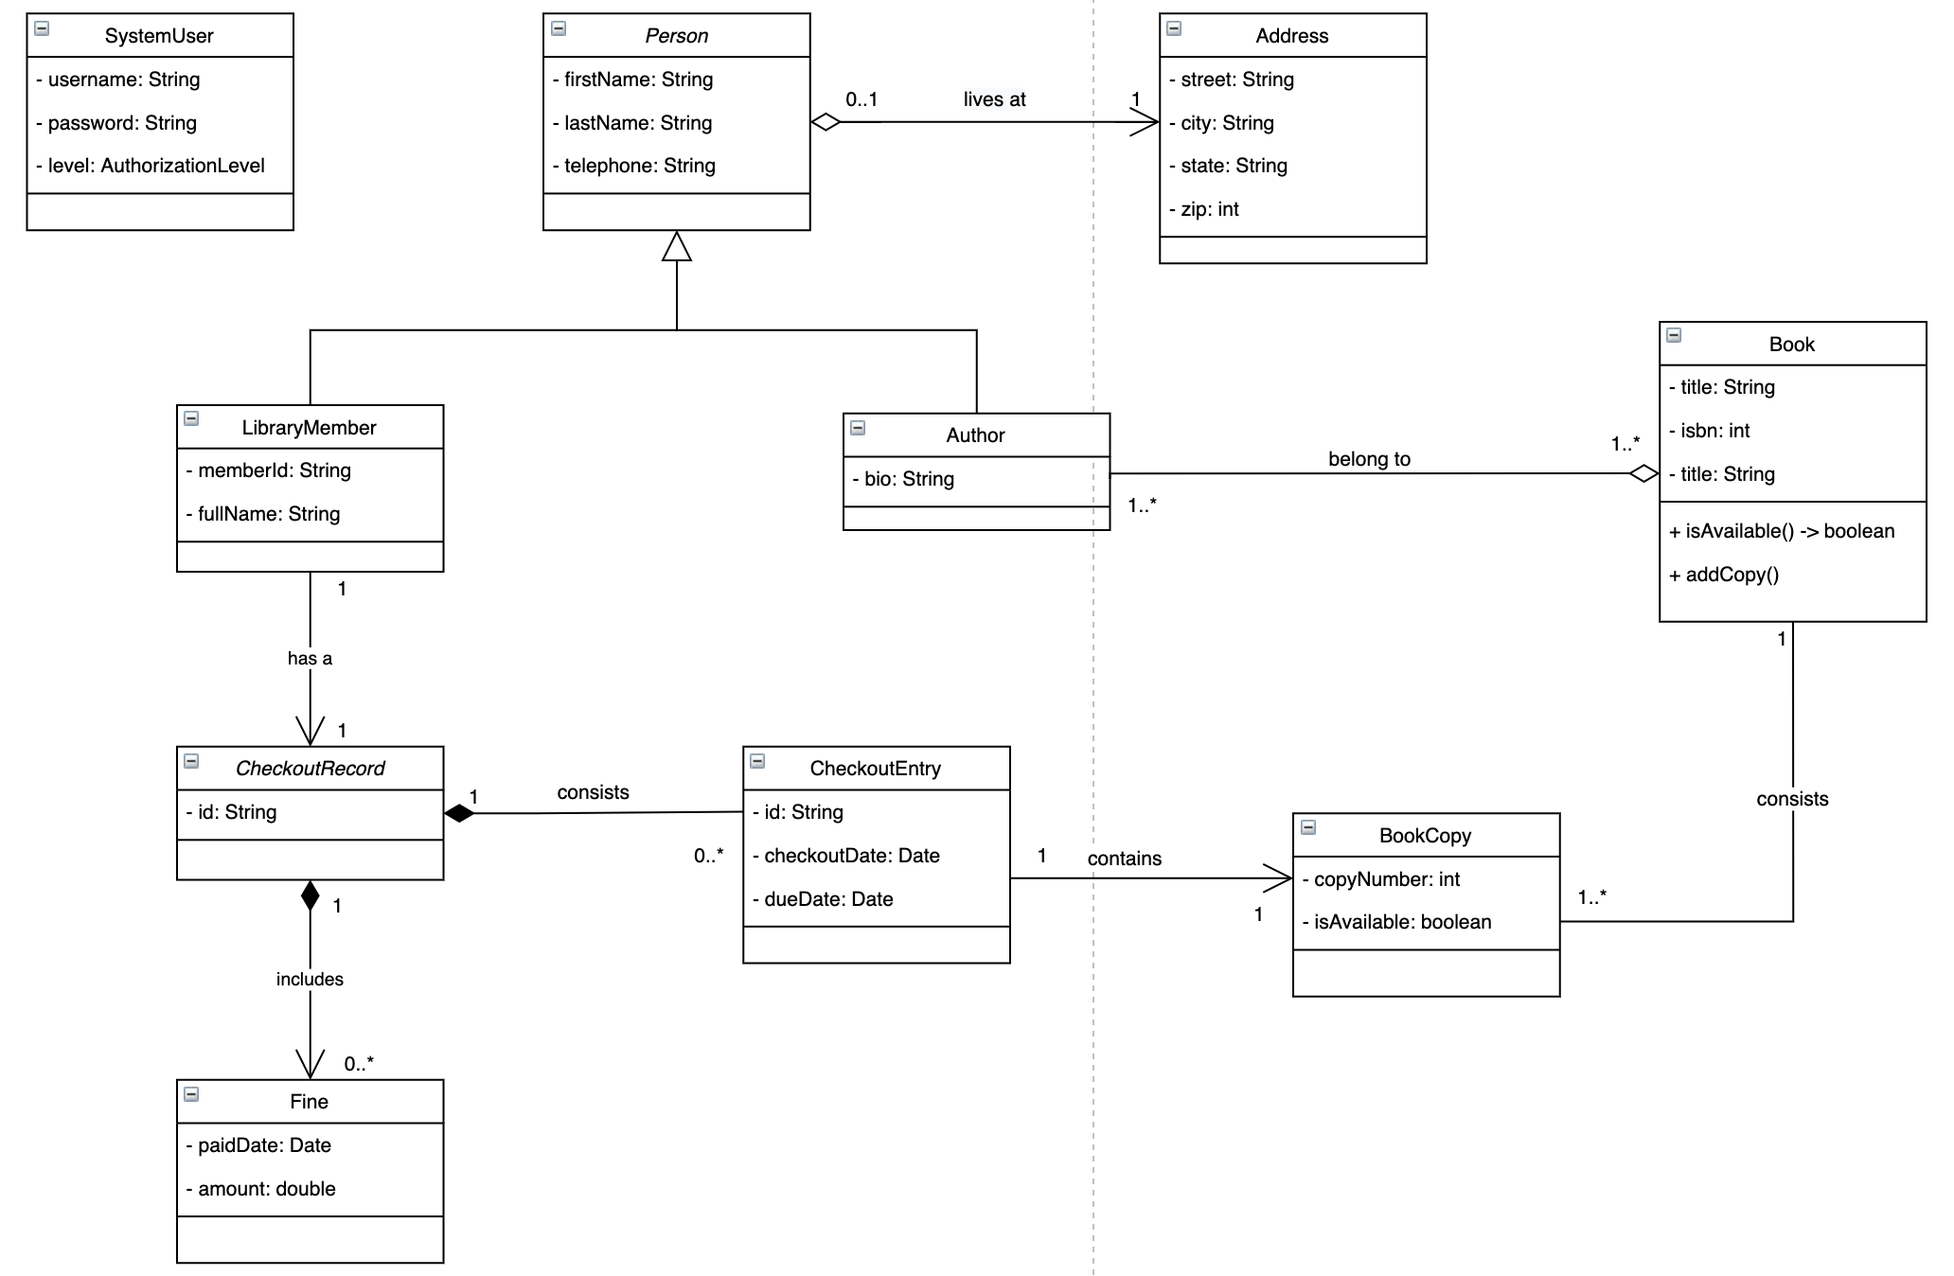
Class Diagram

Slide 4
System Features
Login screen
Dashboard screen
System options according privilege access
Checkout a book
Add a member
Add a book
Add book copy
View checkout records
View books
View members

Slide 5
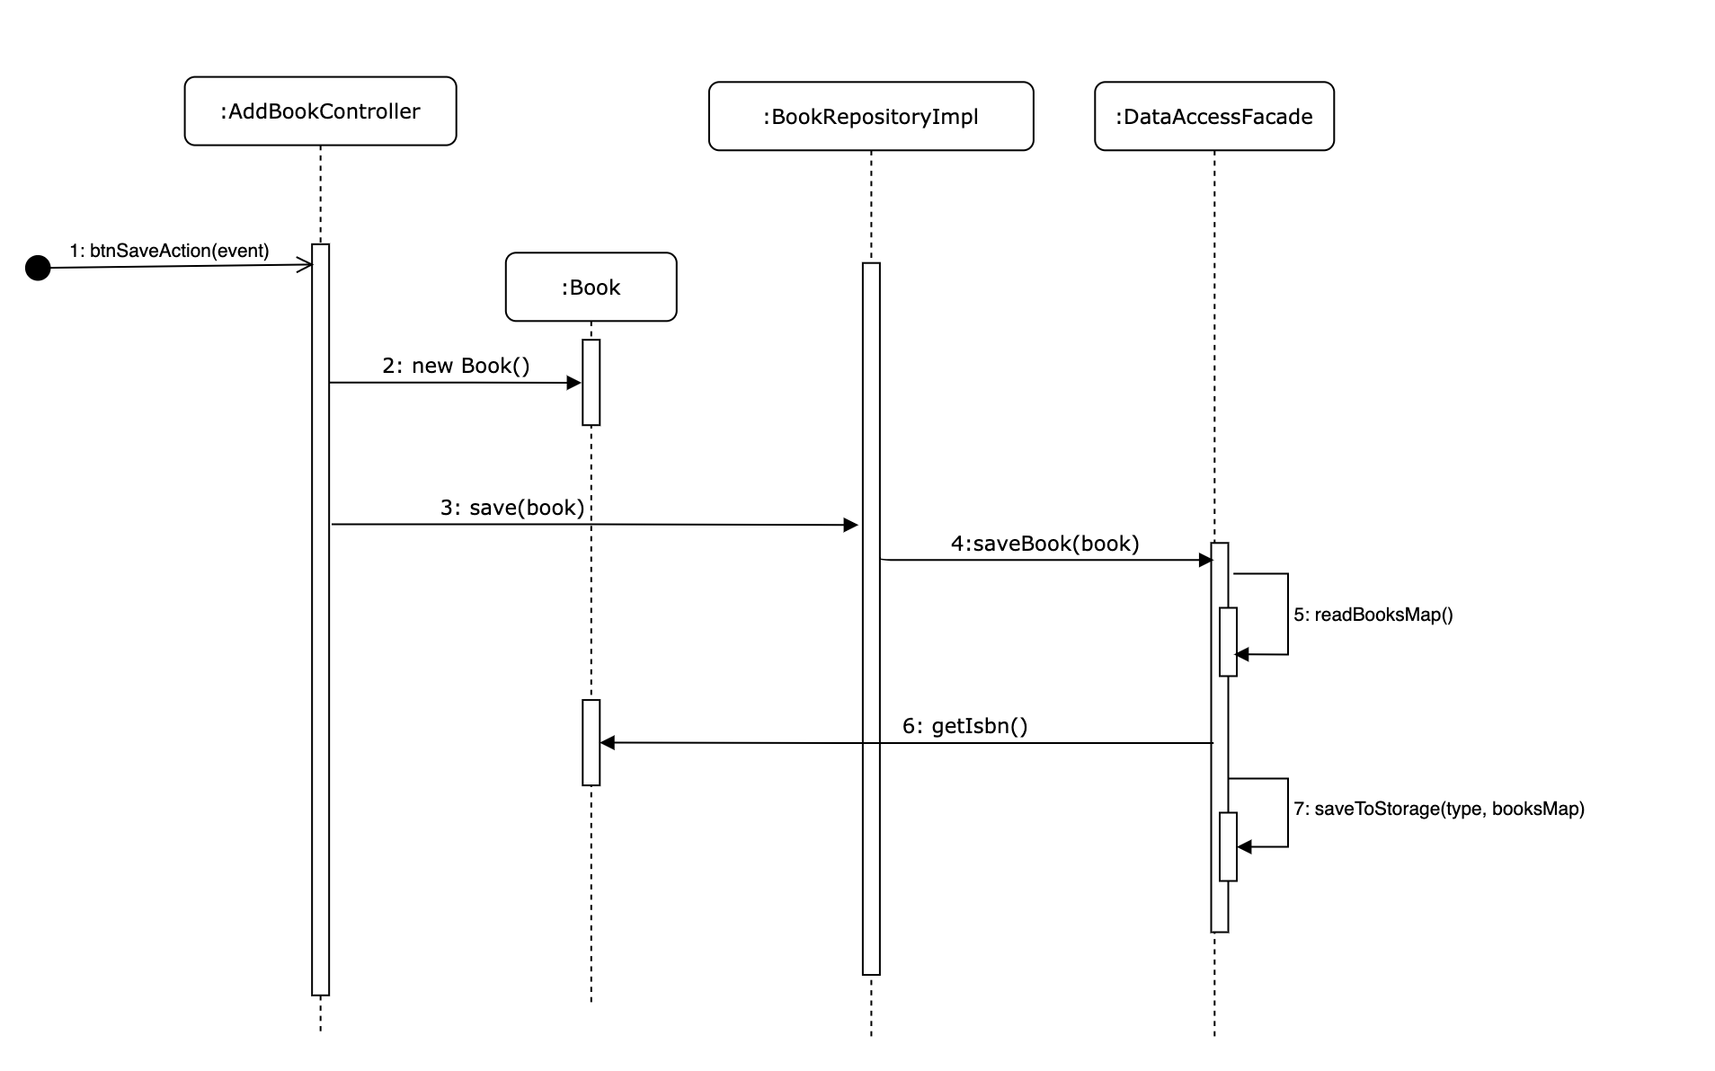
Sequence Diagram
(addBook)

Slide 6
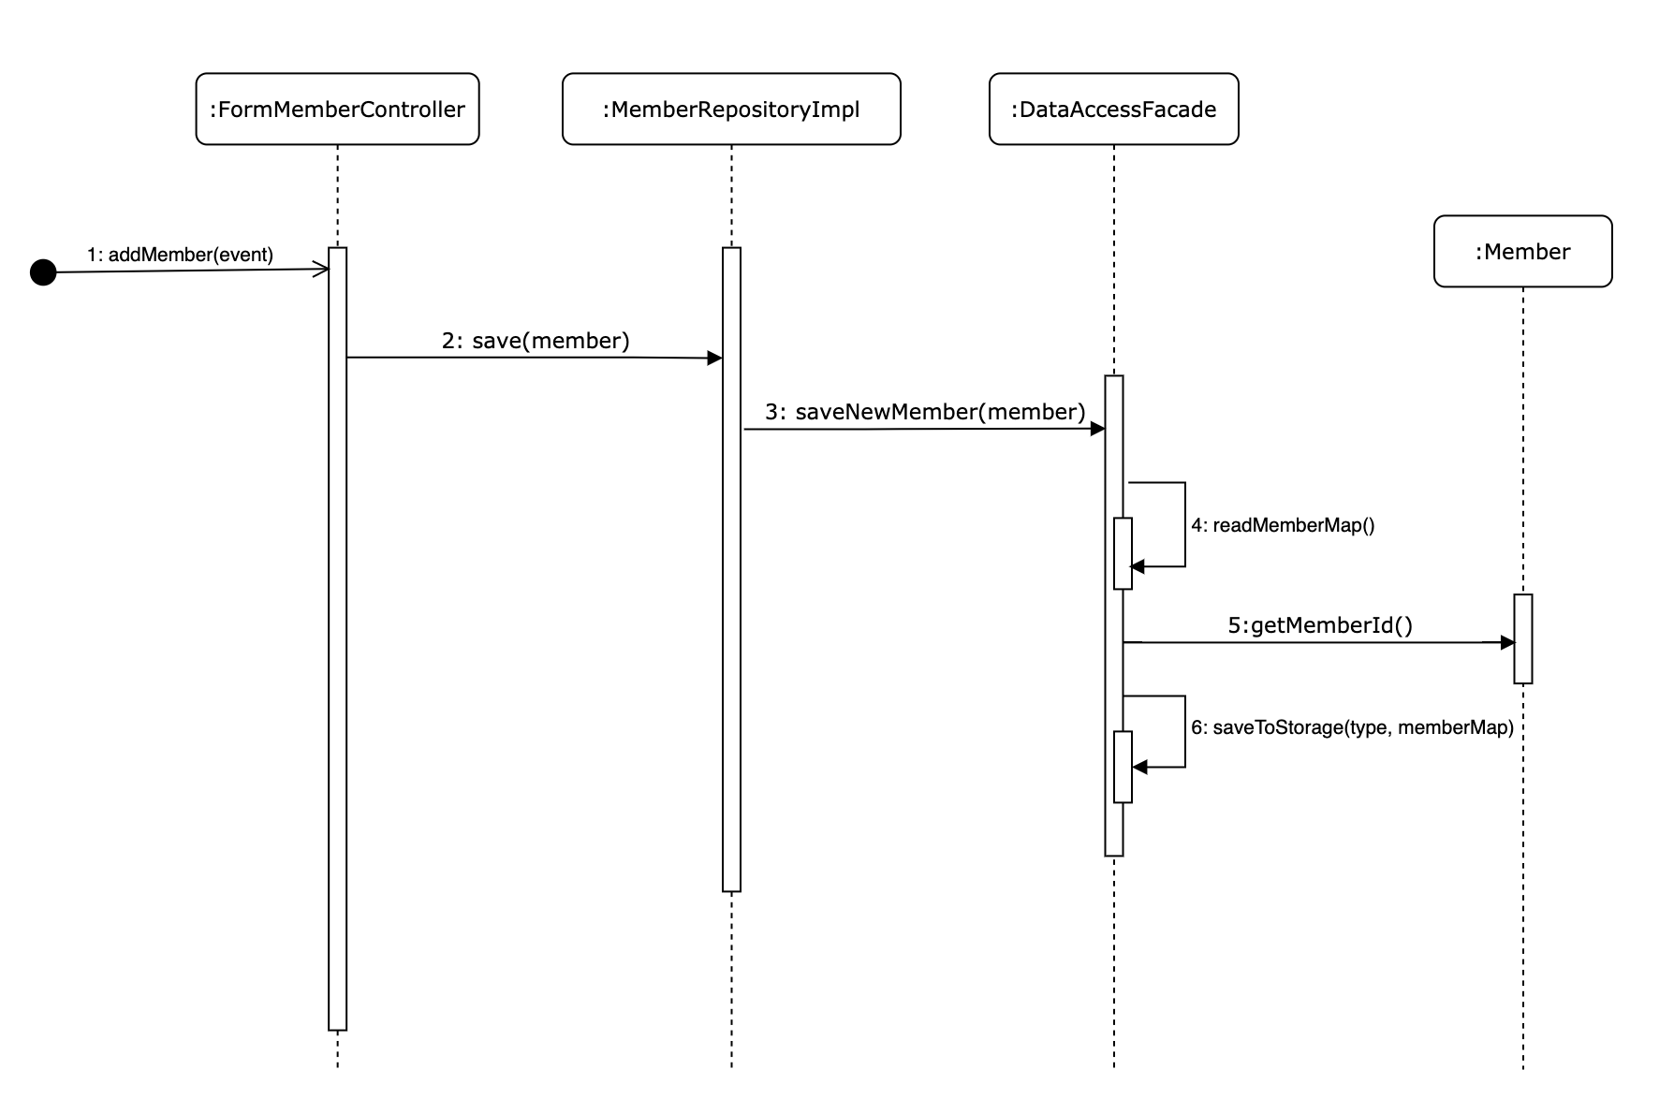
Sequence Diagram
(addLibraryMember)

Slide 7
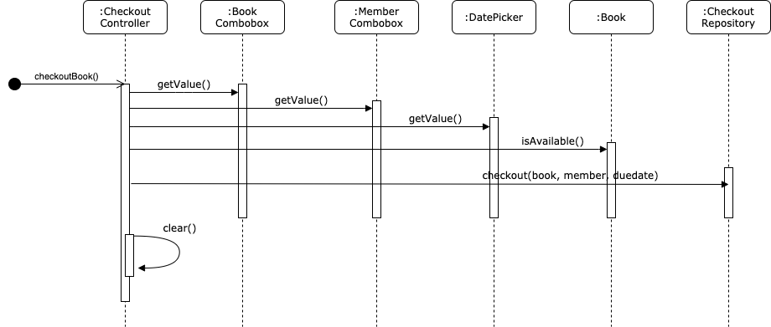
Sequence Diagram
(checkoutBook)

Slide 8
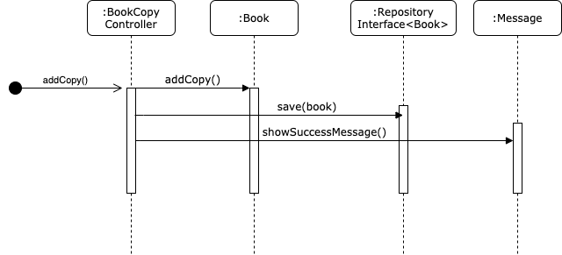
Sequence Diagram
(copyBook)

Slide 9
System Demo

Slide 10
Questions?

